Slide 1



TW109 Tips and Tricks for Migrating to Experience Manager in the Cloud
Kiran Murugulla, Sr. Cloud Architect
Aditi Dutt Chaudhuri, Sr. Product Manager

Slide 2
Key Takeaways
1
How Cloud Acceleration Manager can simplify and accelerate migration self-assessment
2
How to structure and prepare your content and code migration plans
3
How to define your go-live readiness checklist and milestones

Slide 3




Agenda
Overview of migration journey
Self-assessing migration readiness
Creating migration plans
Implementation & Go-live Readiness

Slide 4















Adobe’s Recommended Methodology to Move to the Cloud
Readiness
Planning & Setup
Implementation
Go-live
Optimization
Assessment of AEM best practices being followed
AEM as a Cloud Service provisioning
Get code and project structure ready for AEMaaCS
Code and content freeze periods
Continue to modernize code
•
High-level migration complexity assessment
•
Detailed migration assessment
Performance and security tests
Optimize content
Move existing content and ACLs to Cloud Service
•
Project plan creation and resource planning
Cut-over
Enable IMS SSO for Author

Slide 5

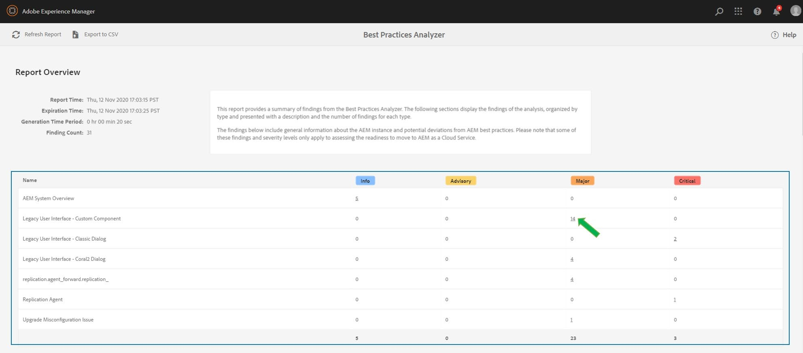

Start your readiness self-assessment with the Best Practices Analyzer
Always use the latest version of BPA
Once installed, available under Tools
> Operations > Best Practices Analyzer
Only available to admin or users in the administrators group
6.1 or above
Recommended to run on a production clone
4 importance levels for violations
INFO
ADVISORY
MAJOR
CRITICAL
https://adobe.ly/3qvrWQ0

Slide 6

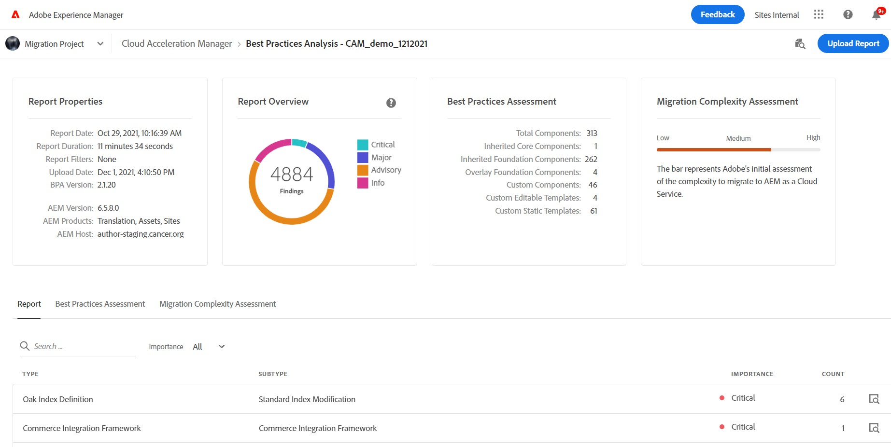

Review your readiness self-assessment in Cloud Acceleration Manager
Benefits of Cloud Acceleration Manager (CAM)
Plan better and smarter
Content Assessment
Code Assessment
Streamline the migration with end-to-end guidance
Guidelines and best practices
throughout the journey
Optimize migration effort
Learn about automation tools to minimize migration time
https://adobe.ly/3ntrm31

Slide 7





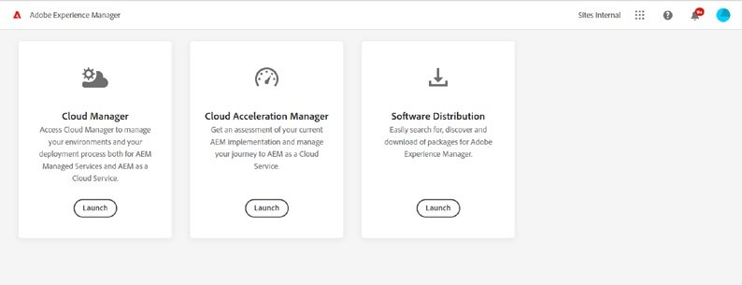
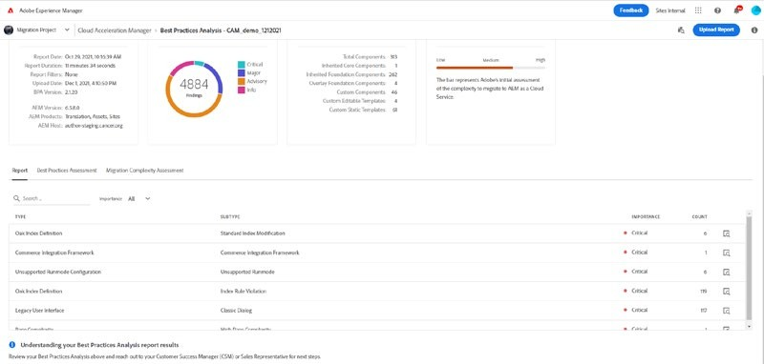





3 Simple Steps to Self-assess Migration Readiness
Readiness
Assessment of AEM best practices being followed
High-level migration complexity assessment
Step 1
Step 2
Step 3
Install & execute Best Practices Analyzer (BPA) and download BPA report
Log in to Cloud Acceleration Manager (CAM)
Upload BPA report in CAM and review assessment

Slide 8


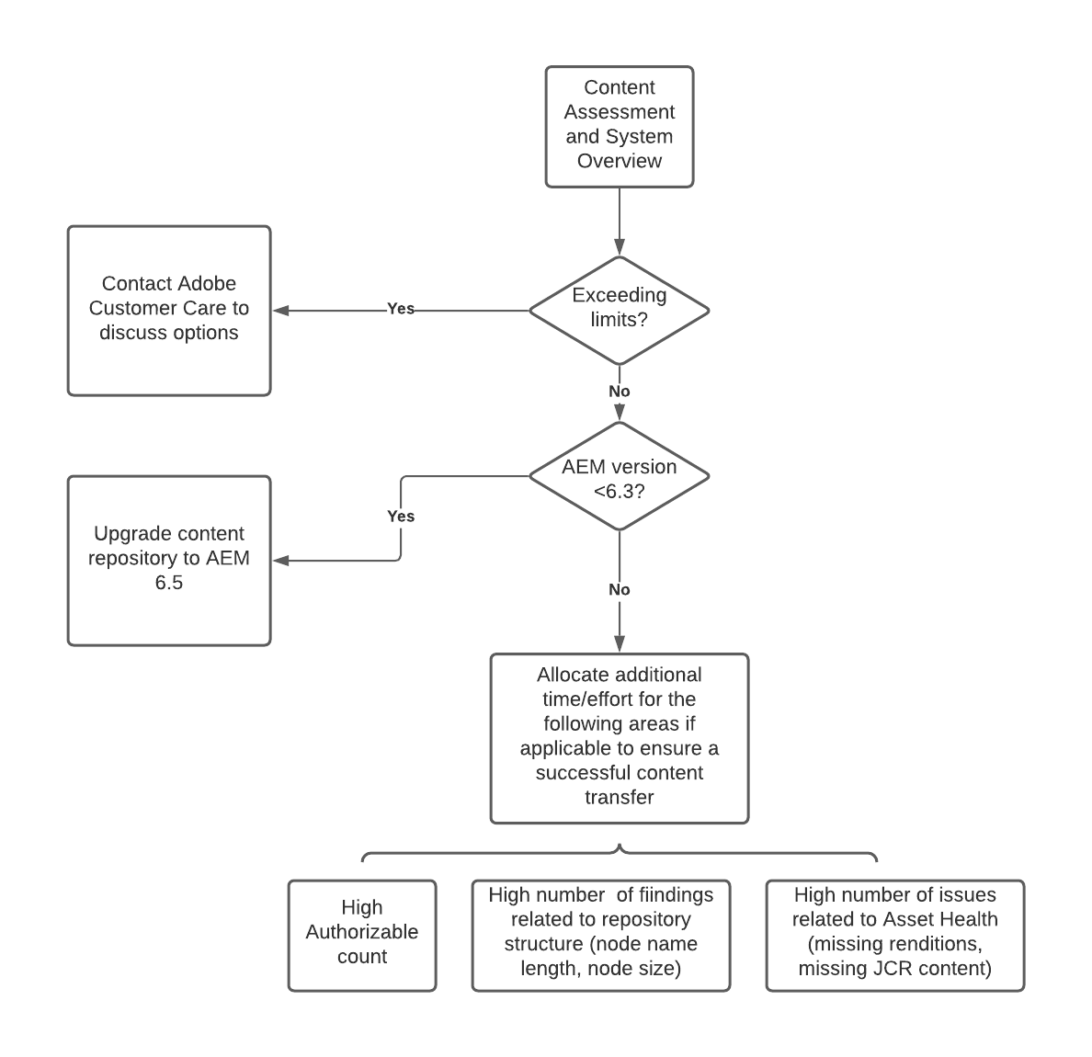
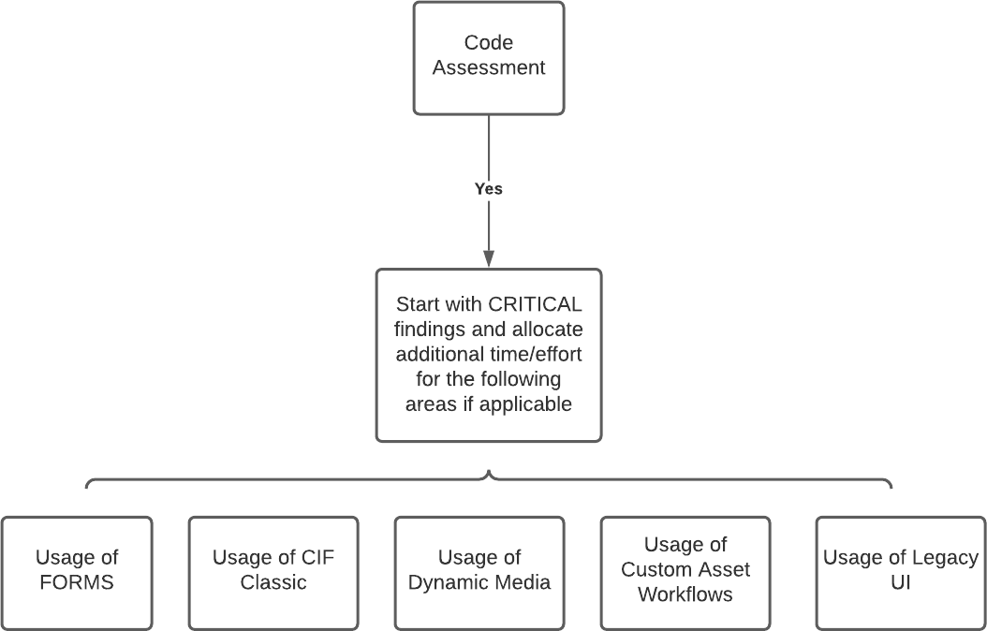
Interpreting your CAM assessment report and migration complexity level
Yes
Do you have a Cloud Service
Content Assessment
Code Assessment
contract?
Start with Content Assessment and then review Code Assessment
Create content migration plan and code refactoring plan

Slide 9
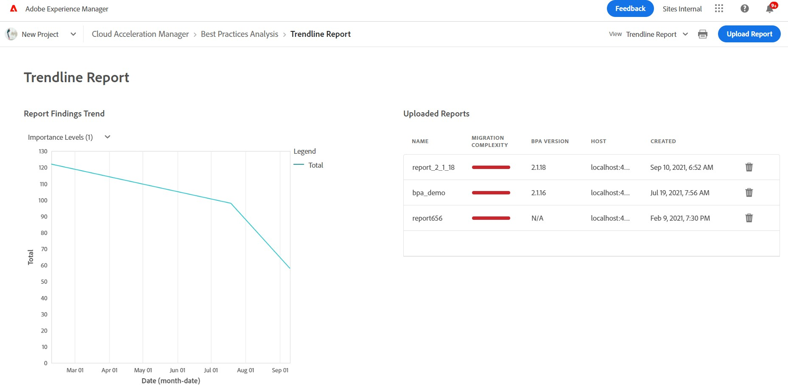


Modernize your code today to ensure a smooth migration in the future
Do you have a Cloud Service contract?
No
Track progress in CAM with Trendline Report
Start with Code Assessment and create a plan to modernize code
Re-run BPA and upload to CAM to determine progress

Slide 10
CAM DEMO – Assessing different migration scenarios

Slide 11
















Planning & Setup
Create a Migration Plan (Content & Code)
Create Environments and Setup Cloud Manager
Strategize DevOps Culture Change

Slide 12






Creating a Content Migration Plan
Pre-requisites:
Content Assessment in CAM
Initial Migration
Partial content transfer: Prod Clone -> CS Dev / Stage
Identify and resolve issues
Record details for initial content transfer
Determine Top up or Full migration before go live
Final content transfer
Full content transfer: Prod -> CS Prod
Record details for top-up/final content transfer
UAT
Performance Tests
Proof of Migration
Top up / Final Migration
Content Transfer Tracker
Content Transfer Planner
Content Transfer Plan | Planned Start Date | Estimated Completion Date | Dependencies | Comments
Top Up migration – Prod Author – CS Prod Author
Final full migration – Prod Author – CS Prod Author
Content Transfer Plan | Migratio n Set Name | Set Size | Source | Destinati on | User Mapping (Y/N) | Extractio n Time | Ingestio n Time | Details
Proof of migration | Set 1 | XX MB | Prod Clone | CS Dev | Y
Initial migration | Set 2
 | Set 3

Slide 13

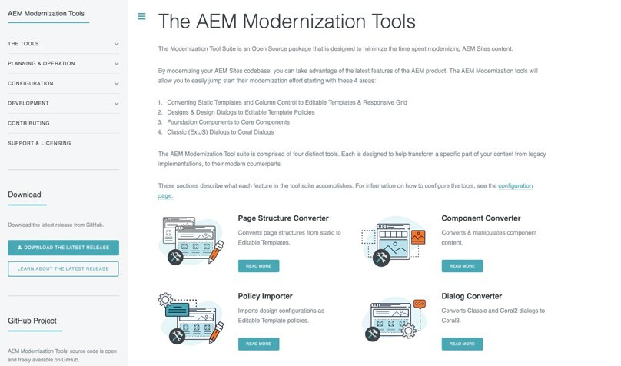
Creating a Code Refactoring Plan
Pre-requisites:
Code Assessment in CAM
Understand Code Refactoring Tools
Simplify by categorizing critical findings:
Front End
Key patterns: LUI, CCOM
Back End
Key patterns: DG, CAV, REP
Configurations
Key patterns: ODI, WRK, URC
Dispatcher
Unified Experience Plugin
AEM Modernization Tool Suite
https://adobe.ly/3tBJuJp
https://adobe.ly/3nt84Lk
Repository Modernizer
Index Converter
Dispatcher Converter
AEM Assets Workflow Migration
Adobe’s code refactoring tools can help reduce effort and accelerate migration

Slide 14







Start content, code, and operational workstreams in parallel to ensure a smooth migration
Content Migration
Code Migration
Operational
QA Strategy Security Review
Content Transfer Tool
Install and Configure
Validate connectivity, available diskspace, cpu etc.
Initial Migration
Create Migration Sets
Extract, Ingest and validate
CS Supported Project Structure
Repository Modernizer
Oak Index Convertor
AEM Workflow Migration
Configure Cloud Manager Pipelines
Env. Specific Pipelines
Front End Pipeline
Quality Pipeli
UAT Plan
Performance Testing
Top Up Migrations
Incremental
Final Migration before Go Live
AZCopy Pre Copy
Install AZCopy
Configure AzCopy
Refactor Dispatcher Configurations
Dispatcher Convertor
Validator and Testing
Iterative Development
Sprint Cycles

Slide 15
Content Transfer Tool DEMO

Slide 16





Go-live readiness before Launch
Content Transfer
Initial Completed
Top up Planned
01
Code Migration
Deployments Working
QA Testing Complete
02
UAT
Execution Complete
Defect Triage and known issues identified
03
Performance Testing
Execution Complete
Review outputs & Optimizations identified
04

Slide 17

Countdown until Launch
Launch Day
T – 1 Days
DNS cutover
Post switch testing
Notify CSME that site has been launched
Monitor logs
T – 2 Days
Go/No-go decision
T – 7 Days
Notify assigned CSME of launch
Production system readiness for launch
Validate rollback plan
Code freeze
Setup monitoring
Setup DNS and SSL certificates

Slide 18
















Helpful Resources
AEM as a Cloud Service documentation
Moving to AEM as a Cloud Service
AEM as a Cloud Service Release Notes
AEM Migration Tools Release Notes
https://adobe.ly/320CWex
https://adobe.ly/3qtmcWR
https://adobe.ly/3nsZJHj
https://adobe.ly/3Kceo3o

Slide 19


Key Takeaways
1
How Cloud Acceleration Manager can simplify and accelerate migration self-assessment
2
How to structure and prepare your content and code migration plans
3
How to define your go-live readiness checklist and milestones
Makes sure to view the following:
S304 –
How Kaufland Transitioned to Experience Manager in the Cloud - to learn about Kaufland’s journey

Slide 20


Q & A

Slide 21
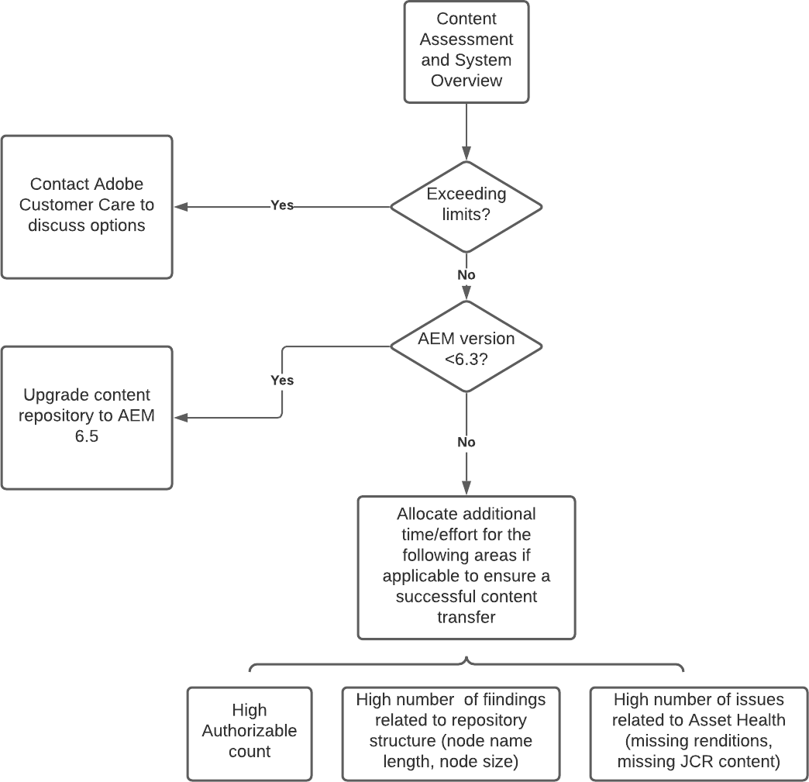
Migration Readiness Self-assessment Templates
Content Assessment
Code Assessment

Slide 22
Content Migration Templates
Content Transfer Tracker
Content Transfer Plan | Migration Set Name | Set Size | Source | Destination | User Mapping (Y/N) | Extraction Time | Ingestion Time | Details
Proof of migration | Set 1 | XX MB | Prod Clone | CS Dev | Y
Initial migration | Set 2
 | Set 3
Content Transfer Planner
Content Transfer Plan | Planned Start Date | Estimated Completion Date | Dependencies | Comments
Top Up migration – Prod Author – CS Prod Author
Final full migration – Prod Author – CS Prod Author

